Slide 1

Worker Threads: The Bigger, The Better
By Vilva Athiban
@vilvaathibanpb

Slide 2
About Me
Javascript Developer, Mostly on the Browser
Open Source / Community person.
I code on JS, React, GraphQL.
New to Berlin
I teach JavaScript / React / GraphQL @JSFactory

Slide 4
Who are we?

Slide 6
MEAN / MERN Stack Devs

Slide 7

Node.js - structure
One Node.js application equals
One Process
One Thread*
One Event Loop
One JS Engine instance
One Node.js instance

Slide 8
Node js - Characteristics
One Node.js application equals
Typical Node.js application: One piece of code runs at a time (Event Loop)
The above process makes it easier for developers - No worries about Race conditions
But the bad part - Hogging the CPU keeps I/O from happening
CPU-heavy applications may have increased latency

Slide 9
The Golden Rule
Don’t block the event loop

Slide 10
How do we handle it today?
Multiple processes
cluster API
It has its own advantages & disadvantages.
Let’s not dig more into it

Slide 11
The future is here - Worker Threads
What is the future?

Slide 12
Worker-Threads
Your code |  | Your code |  | Your code
Node.js |  | Node.js |  | Node.js
V8 | libuv | V8 | libuv | V8 | libuv
Thread |  | Thread |  | Thread
Process
One Node.js application is …
One Process
Multiple threads
One event loop per thread
One JS engine instance per thread
One Node.js instance per thread

Slide 13
How do they communicate ?!
👍 Transferring ArrayBuffers works
👍 SharedArrayBuffers
👍 MessagePort, MessageChannel to pass
startup data

Slide 14
Steps to implement Worker Threads
Import Worker Thread
Spawn a new thread using code / file
Create communication from Main thread (Parent) to worker thread
Do the intended operation in Worker thread
Create communication from worker thread to Main thread (Parent)

Slide 15
Lets See some code

Slide 16
Lets see an example
Find factorial of a number using worker Threads

Slide 17

Import Worker Thread

Slide 18
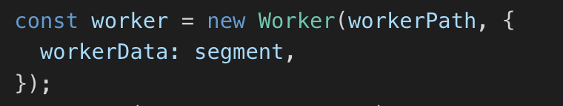
Spawn a new thread using code / file
new Worker(filename) || new Worker(code, { eval: true })

Slide 19
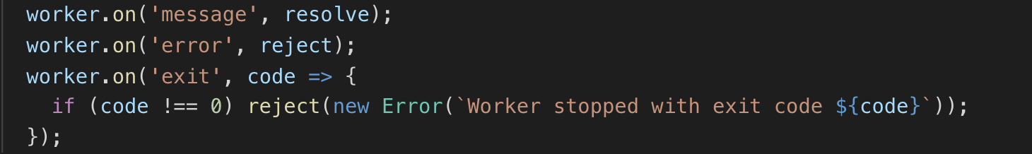
Create communication from Main thread (Parent) to worker thread
worker.on('message'), worker.postMessage(data)

Slide 20
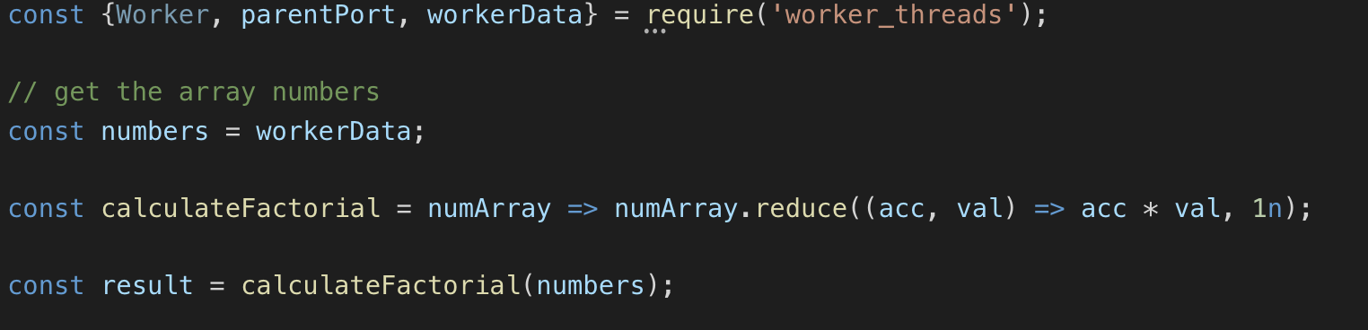
Do the intended operation in Worker thread

Slide 21
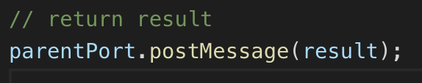
Create communication from worker thread to Main thread (Parent)
parentPort.on('message'), parentPort.postMessage(data)

Slide 22
Next ?

Slide 23
Performance Impact

Slide 24
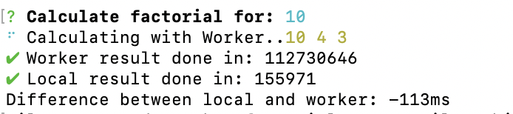
Calculate Factorial
When the input is 10, time take by local function is 113ms lesser than worker threads. Hence, no efficiency on using Worker Threads for tiny inputs.

Slide 25
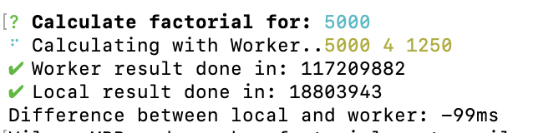
Calculate Factorial
When the input is 5000, time take by local function is 99ms lesser than worker threads. Though the time is lesser than previous case, it’s still not efficient.

Slide 26
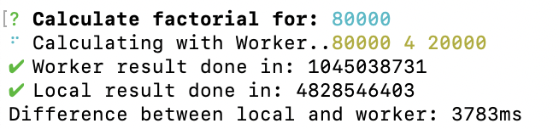
Calculate Factorial
When the input is 80000, time take by local function is 3783ms (~4 seconds) greater than worker threads. When the input is relatively large, worker threads are considerably faster.

Slide 27
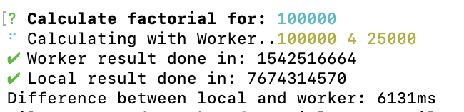
Calculate Factorial
When the input is 100000, time take by local function is 6131ms (~6 seconds) greater than worker threads. When the input is large, worker threads are very efficient.

Slide 28
Key-Takeaways

Slide 29
Worker Threads does not make everything magically faster
For heavy CPU-intensive tasks, worker threads does a great job
Worker threads may be overkill for normal or small tasks
There is still no clear picture on cost of Worker threads, though they seem to be similar to child processes.
Individual thread performance metric, changing .env variables, changing current working directory may not be possible as every thread runs under same process

Slide 30
Q & Maybe A Time
Thank you !
Feedback and Suggestions are welcome
Available for offline discussions
Special thanks to Anna Henningsen
Follow me on twitter - @vilvaathibanpb

